Slide 1
Teen Workshop
Building and Construction for Teens
By Jayne Gillis
Transmedia Storytelling – Pitch Deck
October 2018 – June 2019 (revised)

Slide 2
GROWING NATIONAL PROBLEM
Nationwide, 70% of construction companies report having trouble finding qualified workers, according to Associated Builders and Contractors (Sept. 2018).
For every four people retiring, there is one construction technologist to take their place.
So what are we doing to meet this need?

Slide 3
OPPORTUNITY
Home Depot offers kids building workshops once a month for elementary school children. After that, there is little for building enthusiasts until possibly high school.

Slide 4
SOLUTION / VALUE PROPOSITION
To create a pipeline of workers going into the construction industry + fill the gap left after Home Depot’s Kids Workshops, we need to continue and expand elementary school and begin construction clubs for middle school.

Slide 5
HERE’S THE MAGIC
Shortage of Construction workers
Building clubs nurture future workers in the industry and offer in-demand skills.
Win-Win = Kids learn an in-demand skill and U.S. construction is able to meet demand for workers.

Slide 6
TRANSMEDIA LOGISTICS
To reach intended audiences, the Teen Workshop message will be utilized via three Transmedia platforms.

Slide 7
STORY 1
Reach parents and schools – Video of children in a current construction club model building teen tiny houses.
Platforms: Facebook and Twitter

Slide 8
STORY 2
Reach construction industry – video of future construction technologists.
Platforms: Twitter, LinkedIn

Slide 9
STORY 3
Reach trade groups – Building a pipeline starting with training in elementary through high school.
Platforms: LinkedIn, Twitter

Slide 10
TIMELINE
 | Video | Facebook | LinkedIn | Twitter
Week 1 | Write script | Set up page | Set up account | Set up account
Week 2 | Edit script, casting & location; hire crew | Post still photos #1 | Post still photos #2 | Tweet
Week 3 | Finalize script; shooting | Post still photo #2 | Post still photo #2 | Tweet
Week 4 | Edit video; add music | Post still photo #3 | Post still photo #3 | Tweet
Week 5 | Post video | Post video | Post video | Tweet with link to video

Slide 11
BENCHMARKING
Toolbox is an organization started by Jeff Prothero in Roswell, Georgia.
Jeff has made huge inroads with Chick-Filet and Home Depot, both headquartered in Atlanta.
Partner with Toolbox to facilitate growth of Teen Workhop.

Slide 12
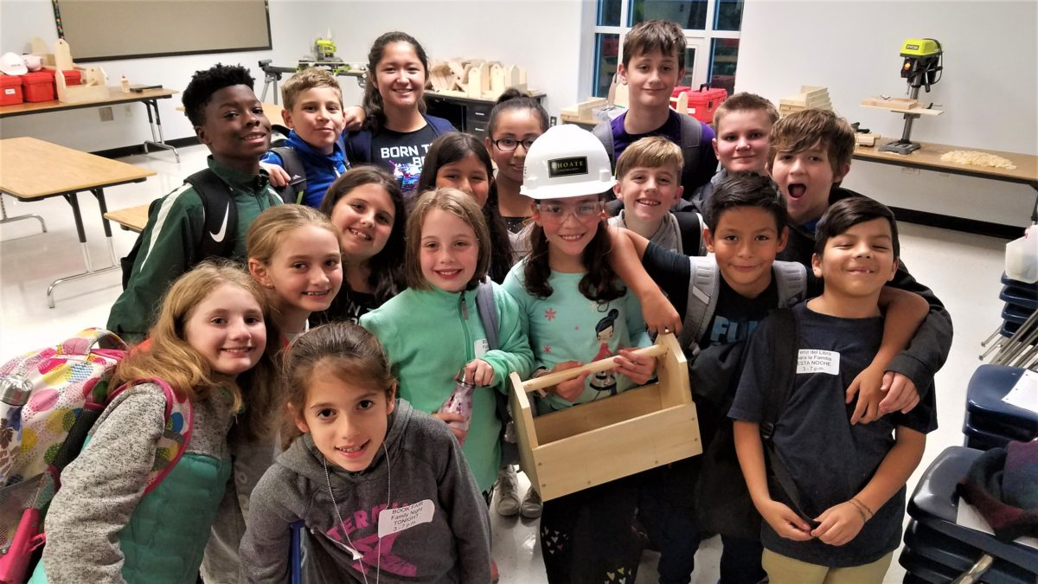

THE TEAM
Teen Workshop
MIDDLE SCHOOLS

Slide 13
BUDGET
Video Equipment, etc.
Camcorder - $1,200
Memory card - $70
Tripod - $160
Camera battery - $130
ZOOM recorder - $220
Wireless lavalier mic kit - $450
Location fees - $800/day X 2 days = $1,600
Production talent - $42/hr. X 4 = $168
TOTAL = $4,000

Slide 14
CURRENT STATUS
Teen Workshop has partnered with Toolbox.
Toolbox’s niche is elementary school.
Teen Workshop’s niche is middle school.

Slide 15
THE WINNING TEAM
Toolbox +
Teen Workshop +
Sponsors

Slide 16



THE TEAM + SPONSORS

